Slide 1
EBEST ENTERPRISE Half Year Sales Report Analysis and Findings
Analysed by: Ebenezer Nii Okai Mensah

Slide 2
Project analysis slide 2
Data Analysis Cycle
ACT
ASK
DAC
SHARE
PREPARE
ANALYZE
PROCESS

Slide 3
Project analysis slide 2
ASK PHASE
About the Company
Stakeholders
Ebest is a fictional company created by the Analyst. The company has different branches around the world that sells different models of chair.
Founder: Esther A. Darko
Financial Advisor: Philip N.A. Mensah
Analysis Question
Business Plan
How can this findings affect our marketing strategies, where to stock more products, how can it boost sales and if possible create an awarding system.
Analyze the half year sales report, come up with a statistical analysis to inform us on your findings and what you recommend.
Data Source
Coursera
Shared by Instructor: Paula Del Rey (Freedom Learning Group)

Slide 4
Project analysis slide 2
PREPARE PHASE
Data and Organization
Credibility and Integrity
Data contains sales from January to June from three(3) different regions. Sales cover the companies that purchased, the model bought, the date, the sales representative who sold to them, the unit price, the total price, and the final price with a discount on some terms and conditions. The data has been stored in a long format.
Data can’t be cited from its original source, but contains six(6) months records which represent the half year which can be used for the analysis.
Licensing, privacy and accessibility
The data is public data and the owner has voluntarily waived all rights worldwide under copyright law. This makes this dataset free to use, modify and distribute without any prior permission.
Software
Data will be loaded in Microsoft Excel for further processing and analyzing

Slide 5
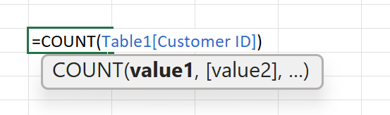
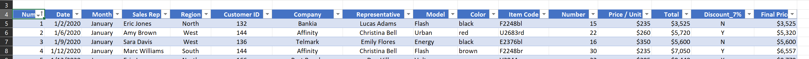
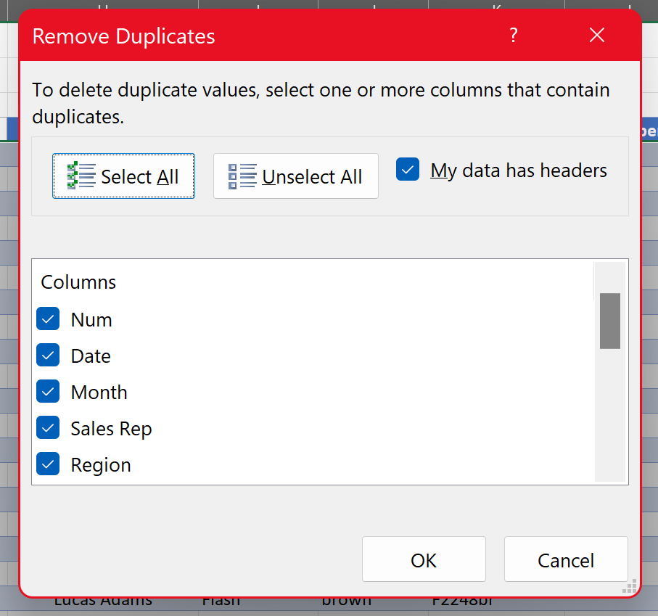
Project analysis slide 2
PROCESS PHASE
Dataset
Dataset contains 16 columns and 80 observations
Cleaning:
Checking for duplicates, removing blanks, removing extra spaces, checking for consistent format
No duplicates were found
Check for extra spaces was done
Consistent data format was checked

Slide 6
Project analysis slide 2
ANALYZE PHASE
1. COMPANY PERFORMANCE ANALYSIS
To help determine the best performing company with us and set our recommendations right. 9 companies bought from us this half year.
Company | Sum of Final Price | Average of Final Price
Affinity | $55,648.50 | $6,183.17
Bankia | $110,389.00 | $6,899.31
Cruise | $77,778.50 | $8,642.06
MarkPlus | $35,680.50 | $5,946.75
Milago | $74,311.25 | $7,431.13
Port Royale | $51,001.75 | $7,285.96
Secspace | $35,832.00 | $7,166.40
Telmark | $69,847.00 | $6,349.73
Vento | $51,621.25 | $7,374.46
Grand Total | $562,109.75 | $7,026.37
TOTAL SALES – HALF YEAR
$562,109.75
AVERAGE SALE – HALF YEAR
$7,026.37

Slide 7
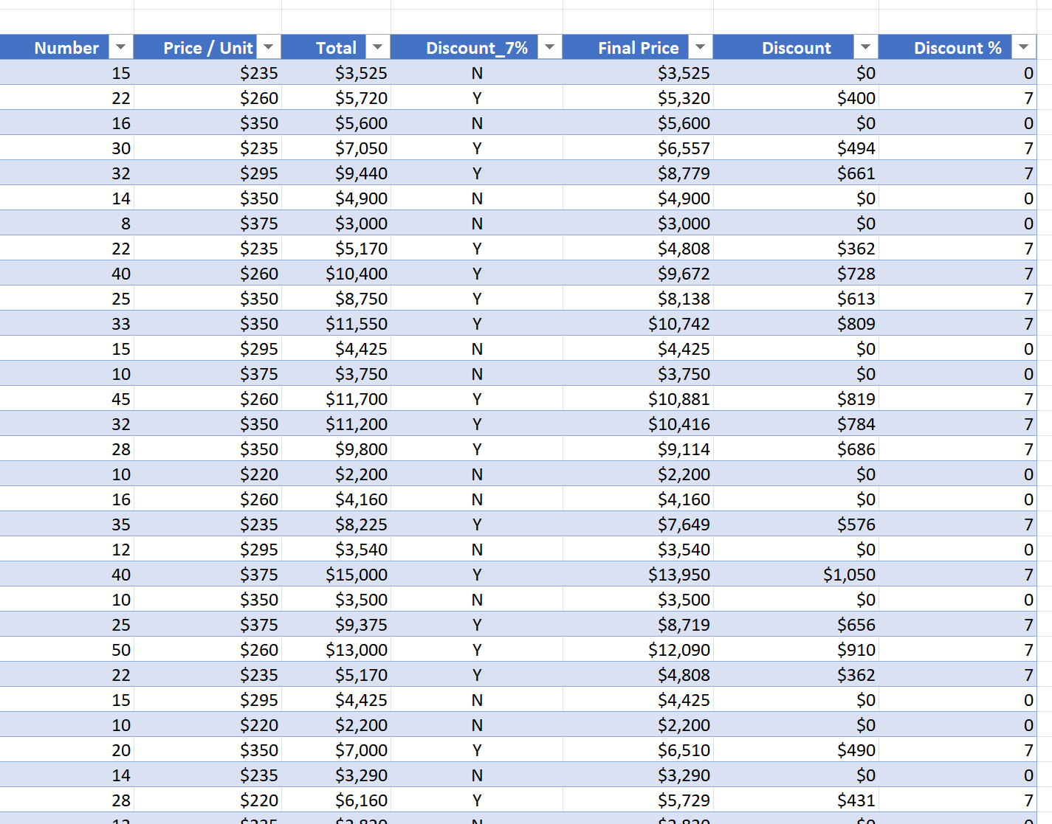

Project analysis slide 2
ANALYZE PHASE
2. DISCOUNT ANALYSIS
Discount analysis will help us check if the discounts are having effect on sales, and also check customer behaviour if discount lead to increased sales.
“Y” stands for sales equal to or greater than 20 and “N” stands for sales below 20.
SALES RECORDED ON DISCOUNT 7%
52 SALES
SALES RECORDED WITHOUT DISCOUNT
28 SALES

Slide 8
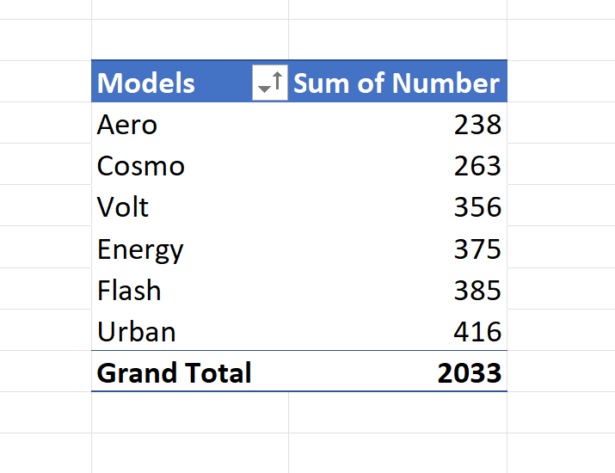
Project analysis slide 2
ANALYZE PHASE
3. TOP SELLING MODEL
By Knowing which model are selling the most, informed decisions about inventory management, marketing strategies and future product development can be made.
MODELS
6 CHAIR MODELS
HIGHEST CHAIR MODEL SOLD
URBAN

Slide 9
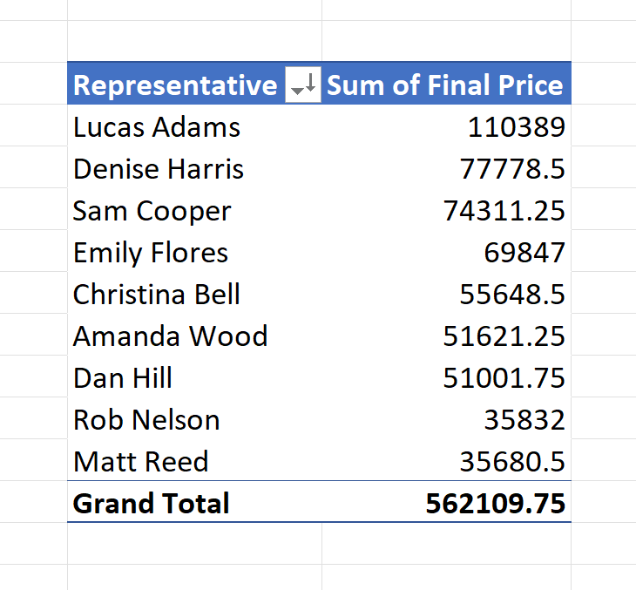
Project analysis slide 2
ANALYZE PHASE
4. TOTAL SALES BY SALES REPRESENTATIVE
This will help us gain insights into individual performance and contribution to the overall revenue. Incentive programs for sale representatives can also be drawn.
NUMBER OF SALES REPRESENTATIVE
9 Representatives
HIGHEST SALES REPRESENTATIVE
LUCAS ADAMS

Slide 10
Project analysis slide 2
SHARE PHASE
COMPANY PERFORMANCE ANALYSIS
Highest Total Sales (Bankia): Bankia company achieved the highest total revenue, indicating strong sales performance and a significant contribution to the overall revenue.
Highest Average Sales (Cruise): Cruise company achieved the highest average sales amount per unit, transaction, indicating efficiency in generating higher revenue from individual sales or customer interactions.

Slide 11
Project analysis slide 2
SHARE PHASE
DISCOUNT ANALYSIS
As discount percentage increases by 7%, total sales amount also tends to increase, it suggests that higher discounts may lead to higher sales in the future based on the trendline projection.

Slide 12
Project analysis slide 2
SHARE PHASE
TOP SELLING MODEL
The Urban model was purchased more. The Aero model had the least purchase of all.
This analysis will give us further recommendations on how to stock, manage inventory and etc.

Slide 13
Project analysis slide 2
SHARE PHASE
TOTAL SALES BY SALES REPRESENTATIVE

Slide 14
Project analysis slide 3
ACT PHASE
RECOMMENDATIONS
Leverage:
1. Strengthen marketing strategies, customer relationships and identify more opportunities for further growth with Bankia and Cruise Companies.
Company feedback: 1. Identify gaps and areas of opportunity, for the other companies, through feedback on purchases.
2. Focus on the models each company needs most.
Maintain and Increase Discount:
1. Discounts on sale for chairs equal to or above 20 should be continued.
2. The firm should also implement more discount strategies in the near future.

Slide 15
Project analysis slide 3
ACT PHASE
RECOMMENDATIONS
Promote High-Performing Products
1. Promoting and optimizing hire-performing products such as Urban models across all regions.
Inventory Management
1. Management must increase their stocks for Urban models.
2. Also Implement strategic marketing to models that are not fairing well in terms of lower purchases.
Incentive and Coaching Programs:
1. Awarding systems should be created for best sales representatives.
2. Sales Coaching and Training targeted at weaker performers.

Slide 16
Project analysis slide 2
FURTHER EXPLORATION
It would be beneficial to conduct a thorough analysis of Cruise’s and Bakia’s sales approach and identify the factors contributing to their success.
Further analysis on why some models are selling than the others. Identify reasons to that and look out for correlation between the dataset.

Slide 17
Thank You

